Slide 1




Evaluation of Stress Tolerant Orphan Legumes for use in Dryland Farming Systems across sub- Saharan Africa and India –Promoting India-Africa Framework for Strategic Cooperation
Stress Tolerant Orphan Legumes (STOL) Annual Meeting
Speaker: M.Samuel Jeberson
Date: 22nd Nov, 2023

Slide 2
Table of 18 Marama bean accession

Slide 3
Marama bean field trials
No. of Genotypes : 18
Number of Rows : 18
Plants per Rows : 10
Spacing : 5m x 5 m

Slide 4
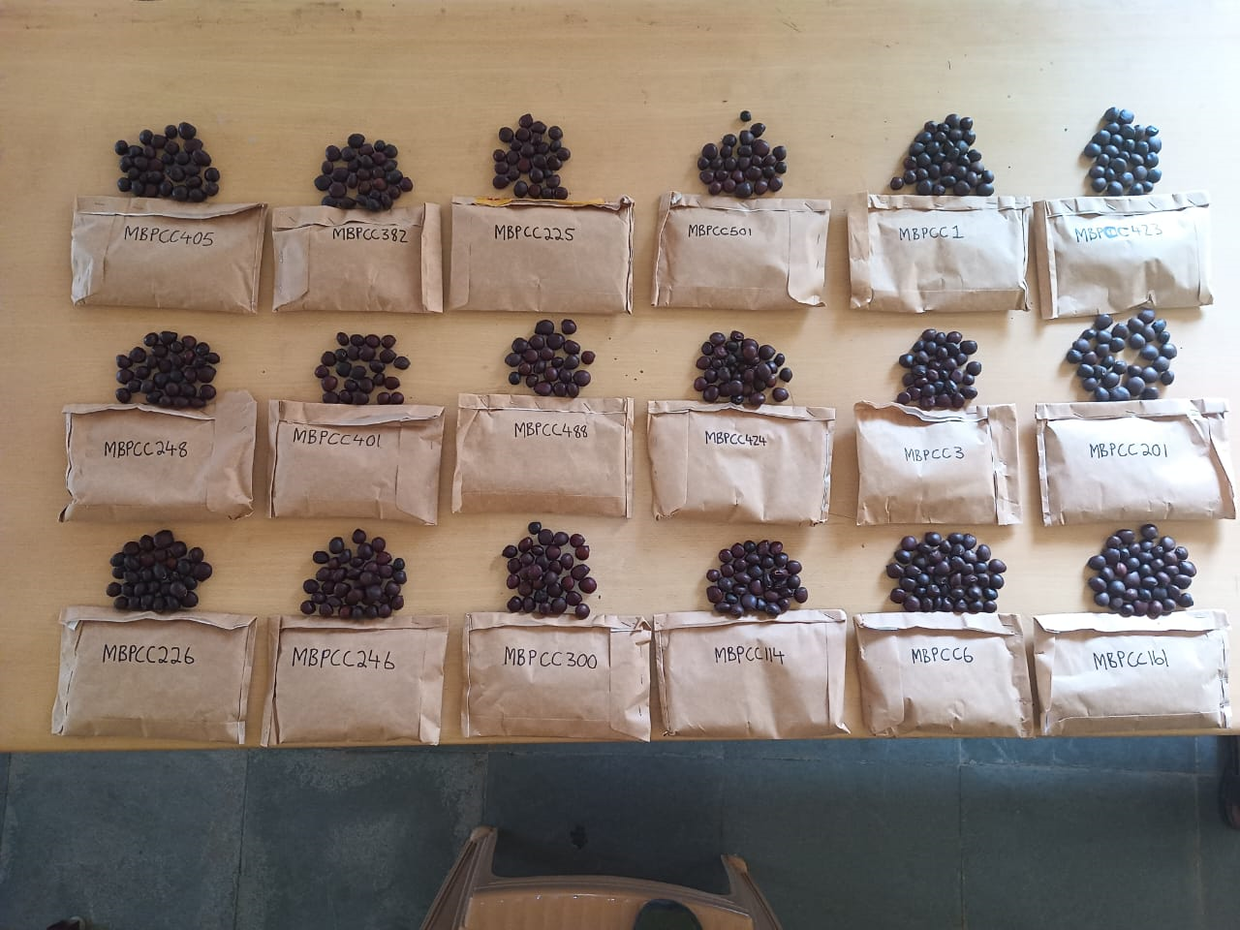
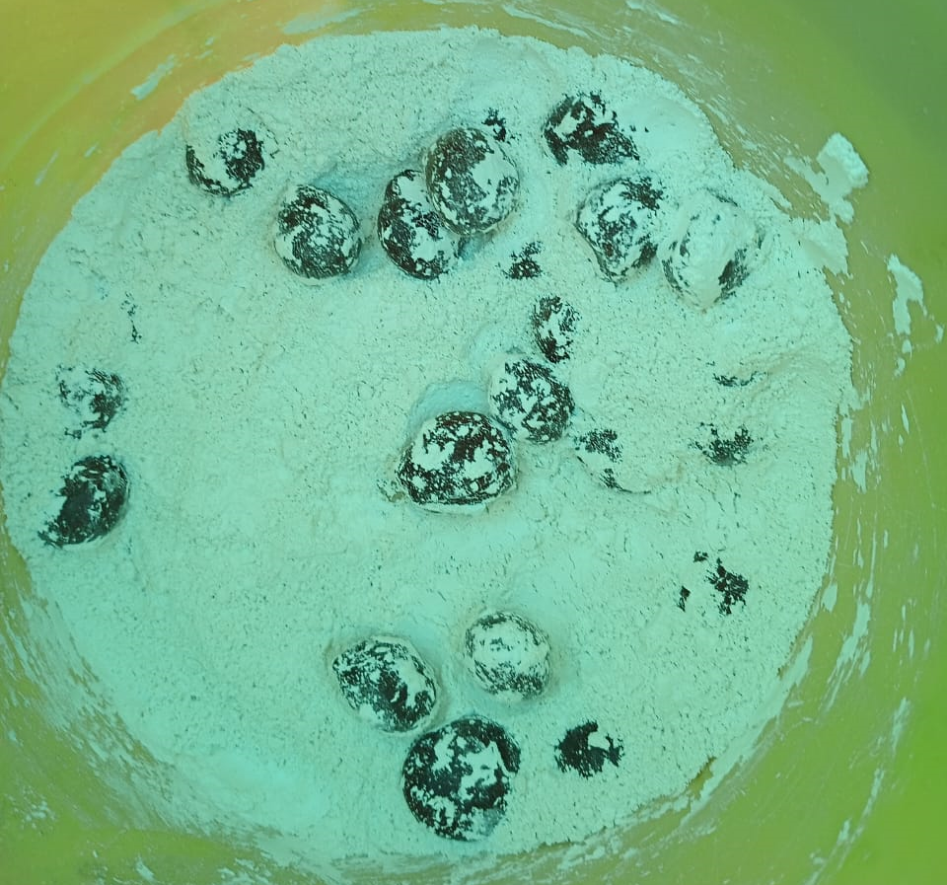
Establishment of Seedlings

Slide 5
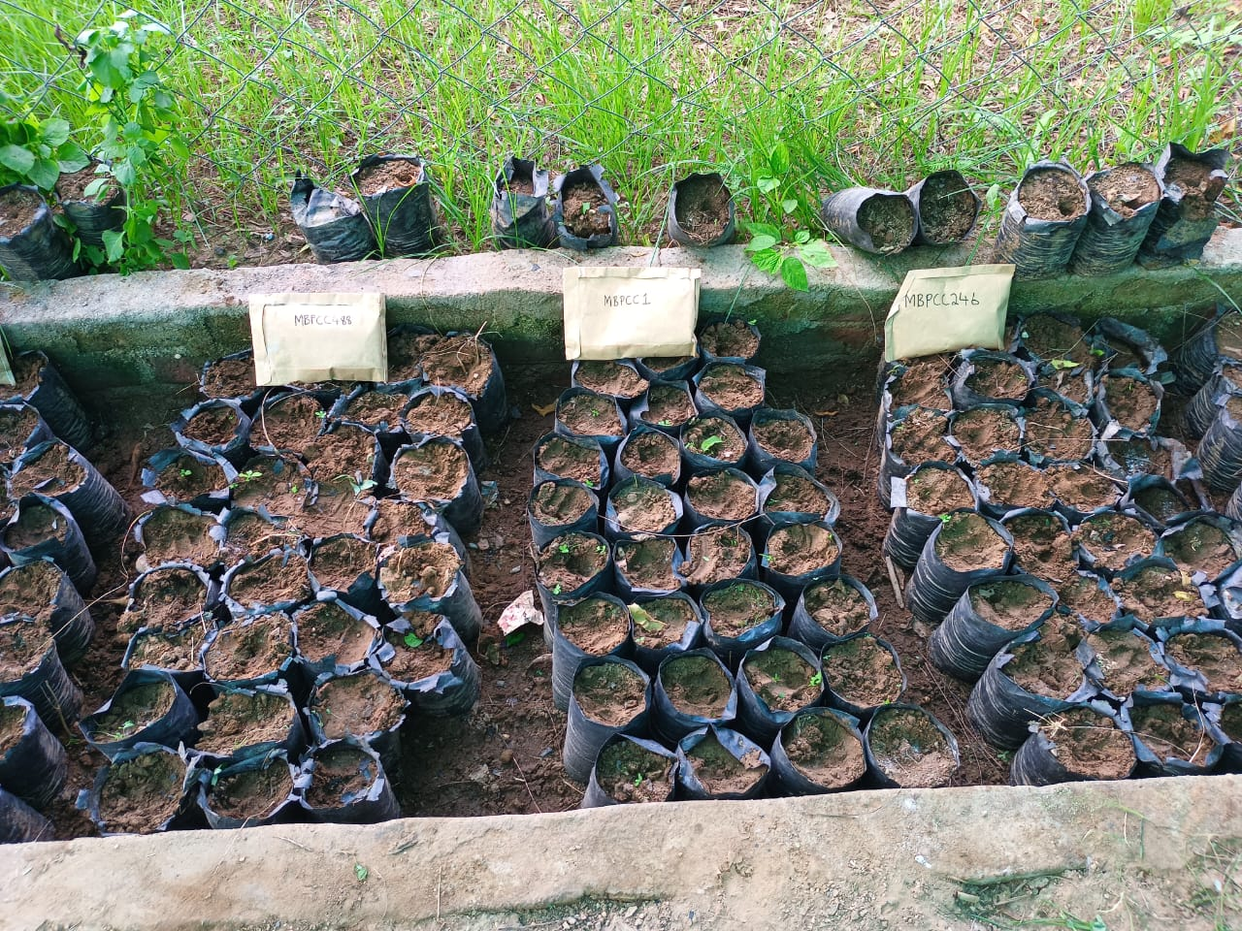
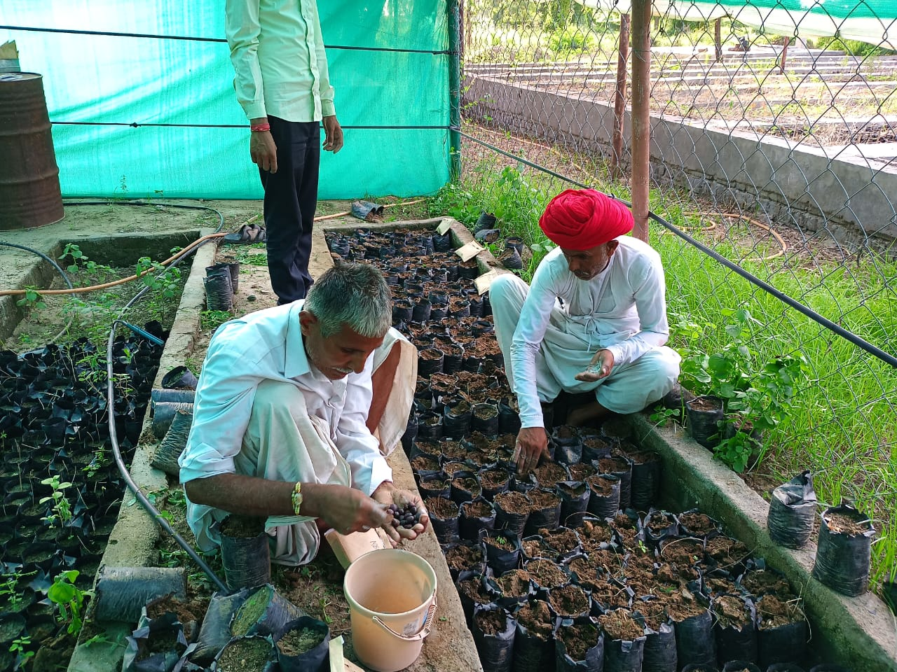

Slide 6
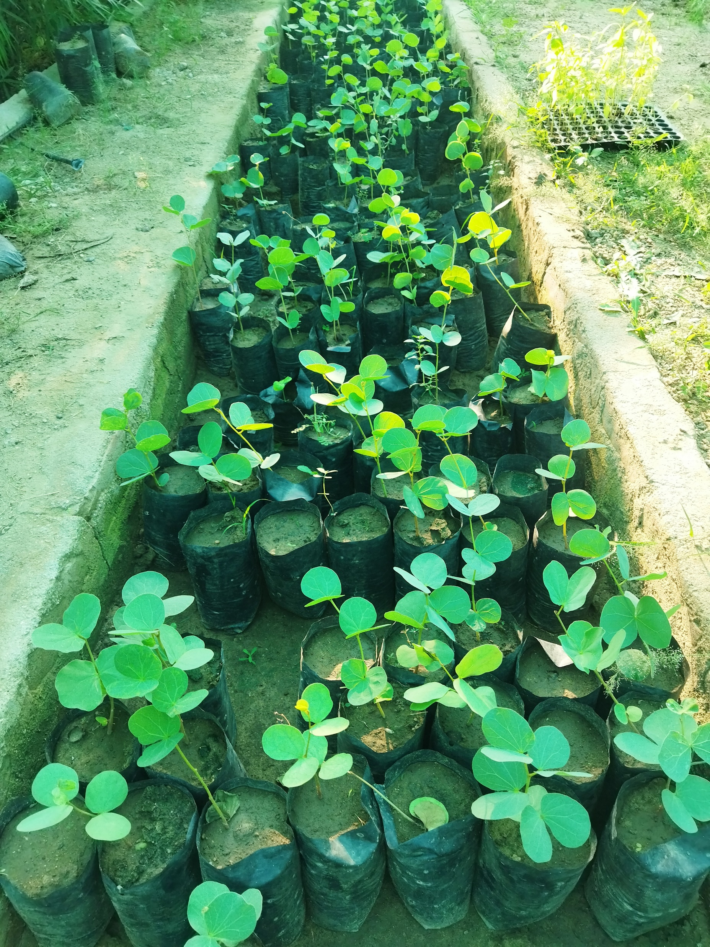
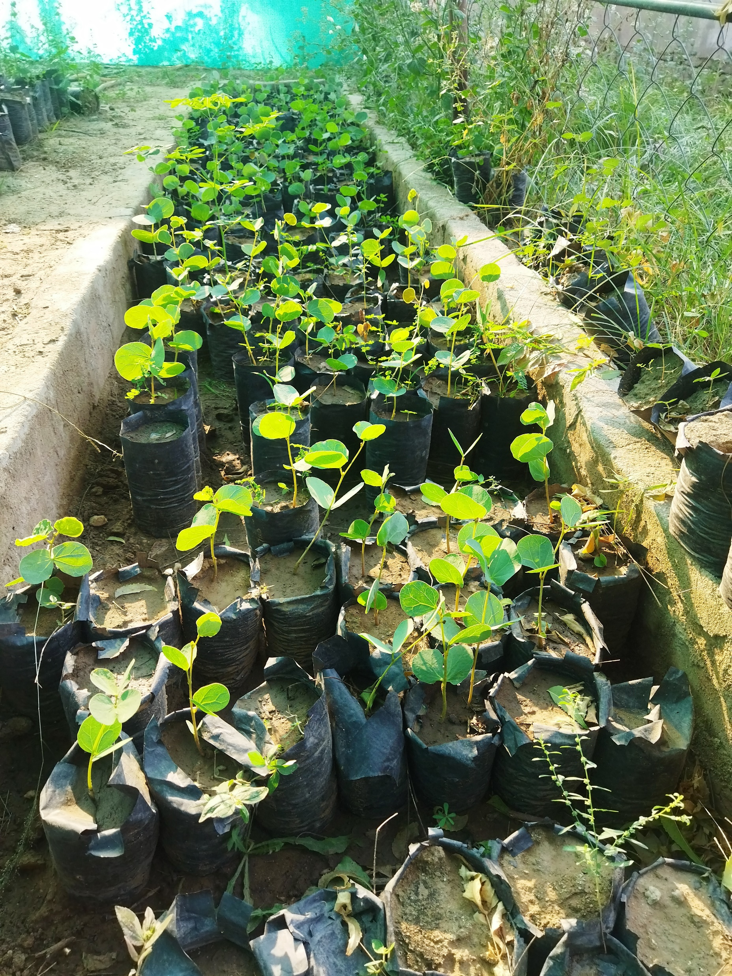

Slide 7
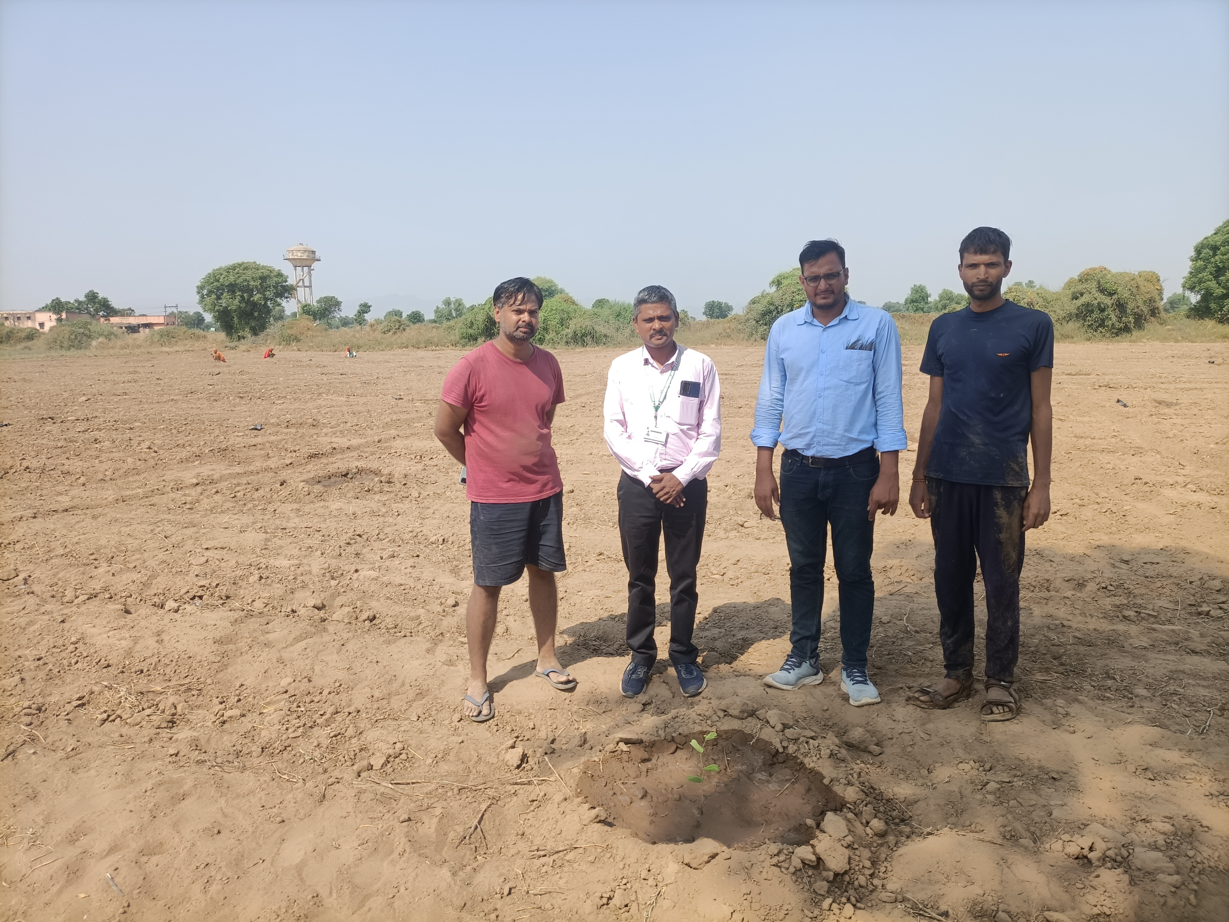
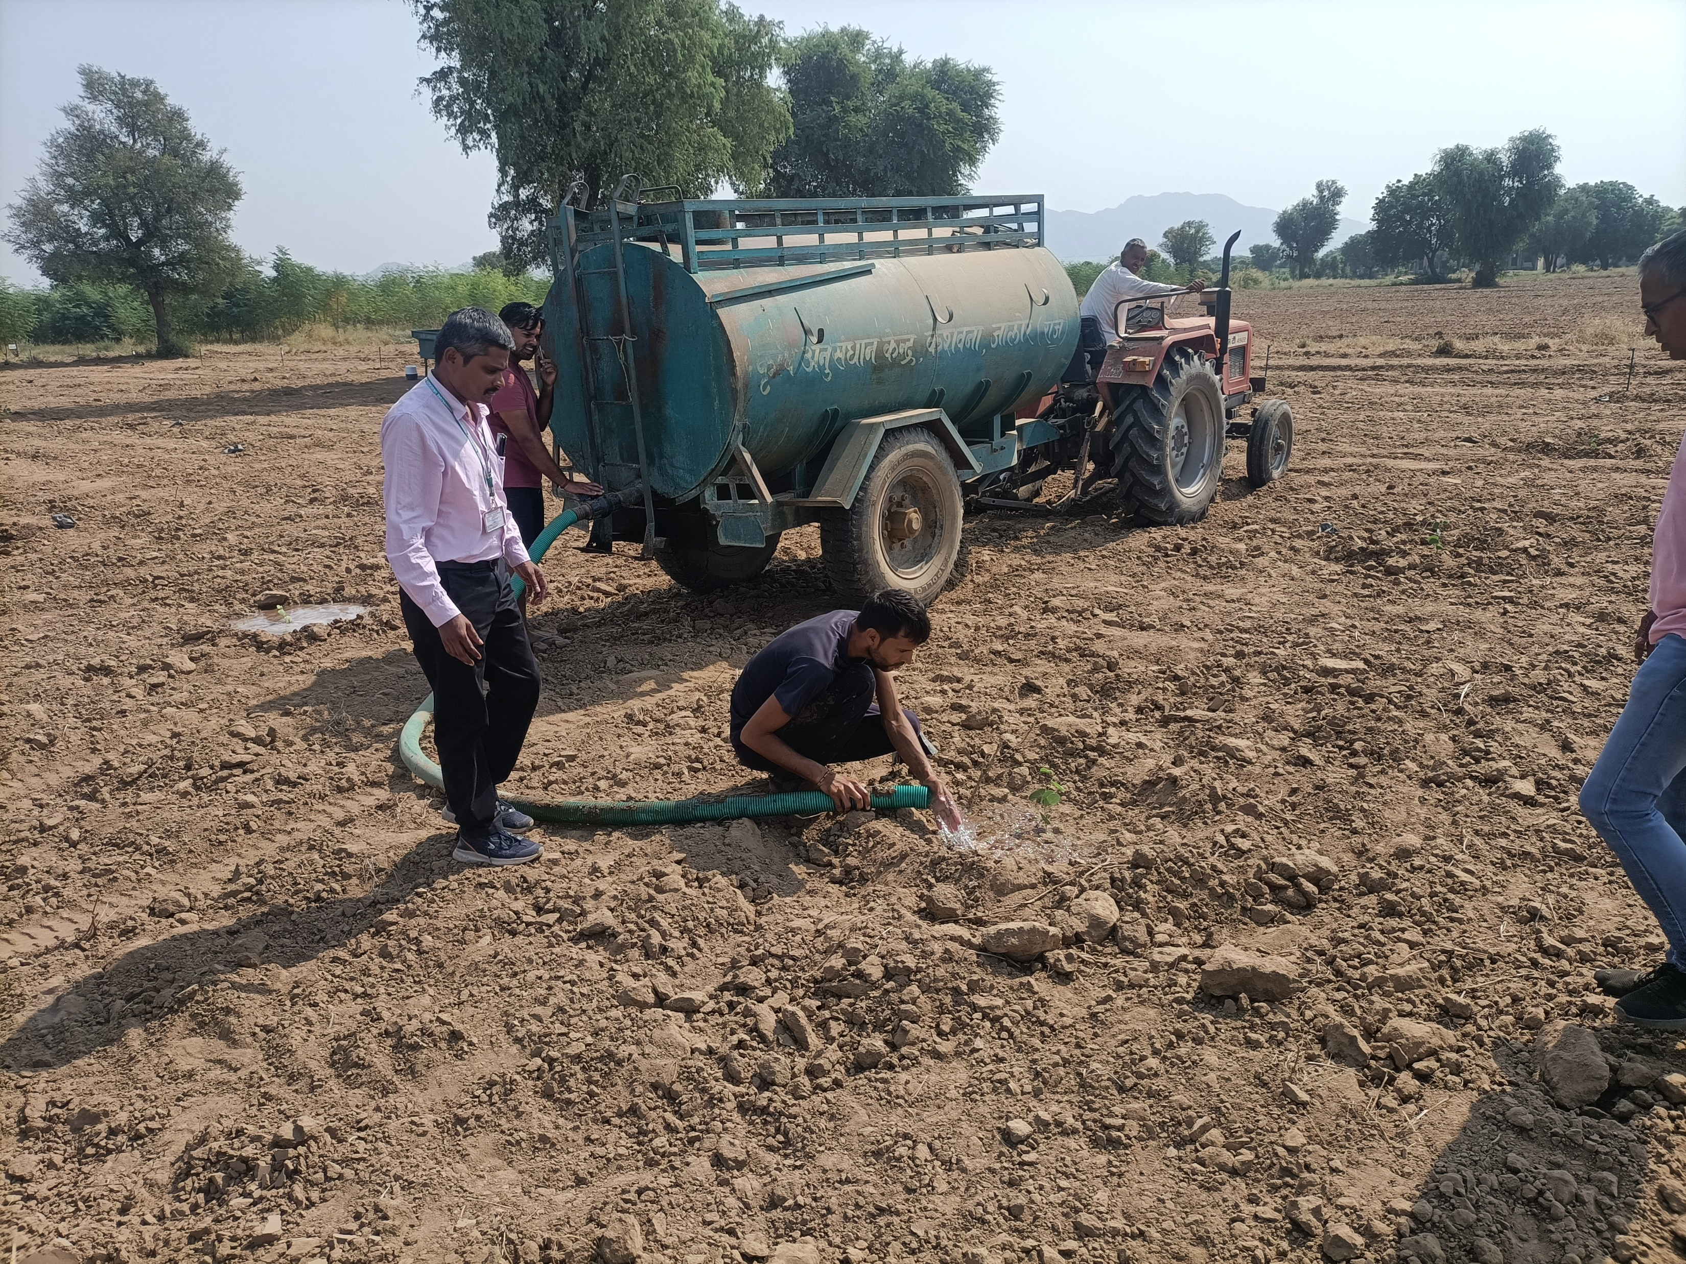

Slide 8
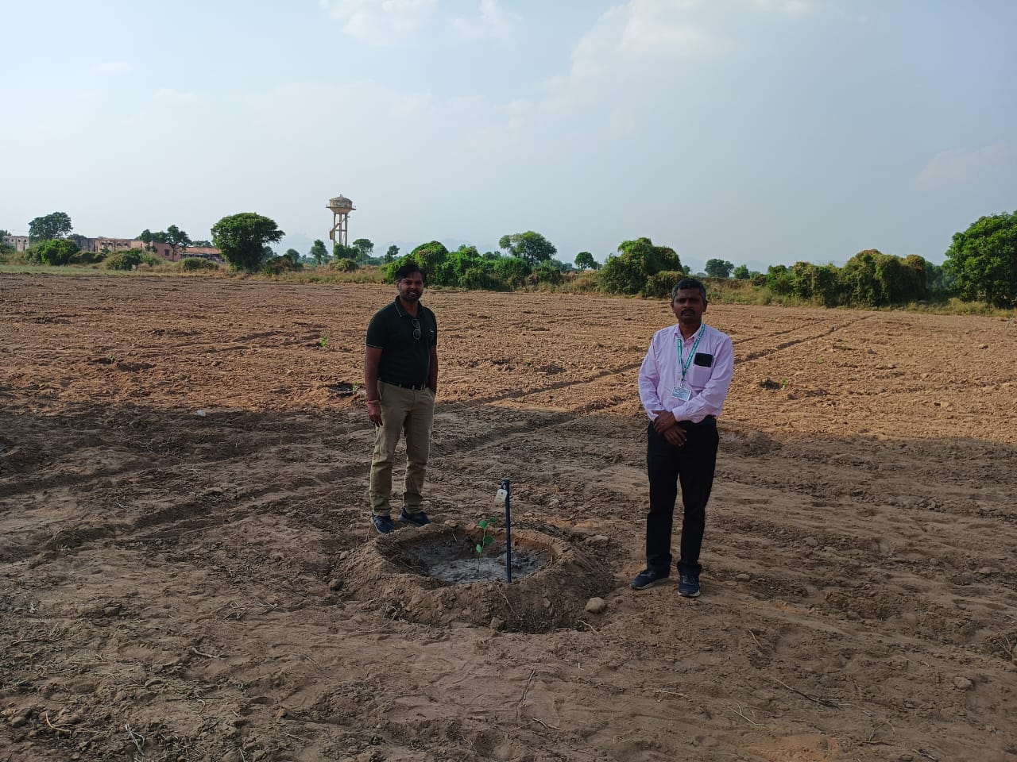
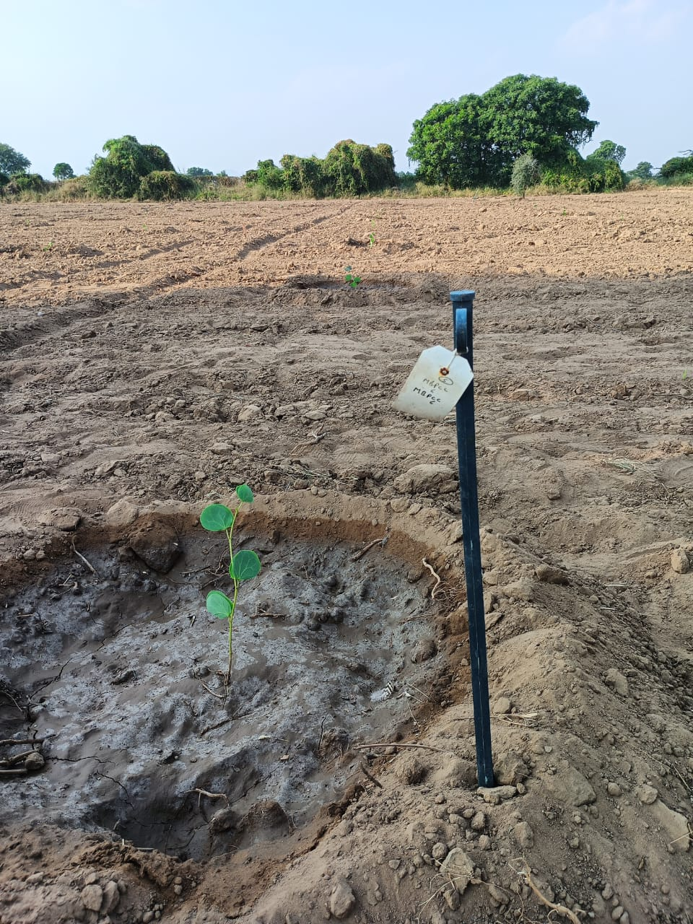

Slide 9
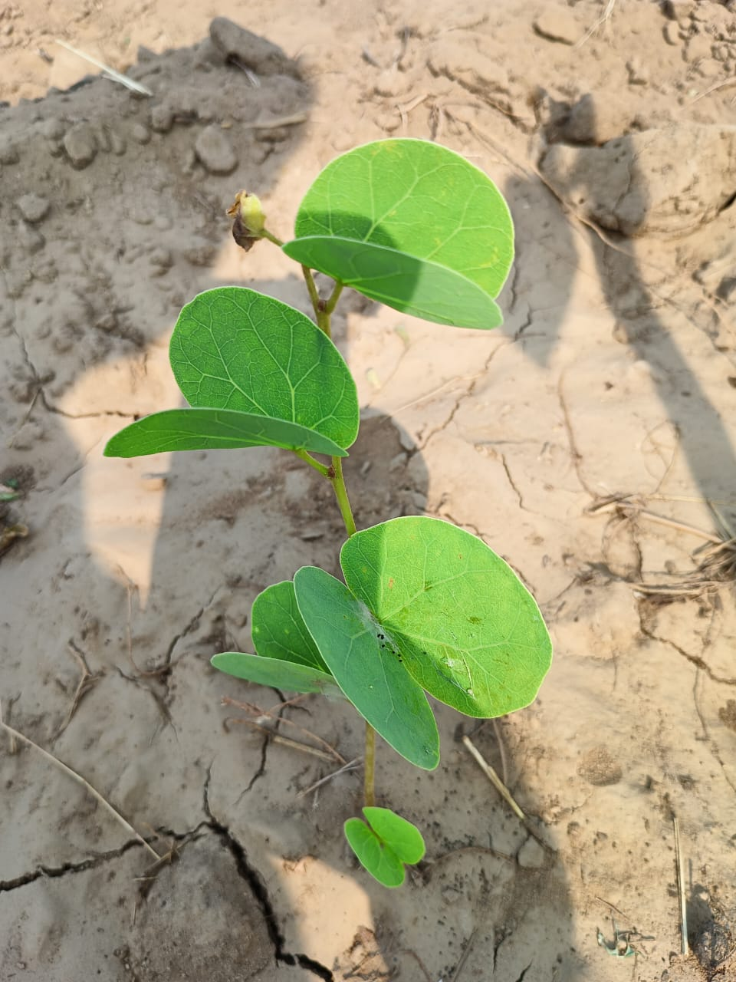
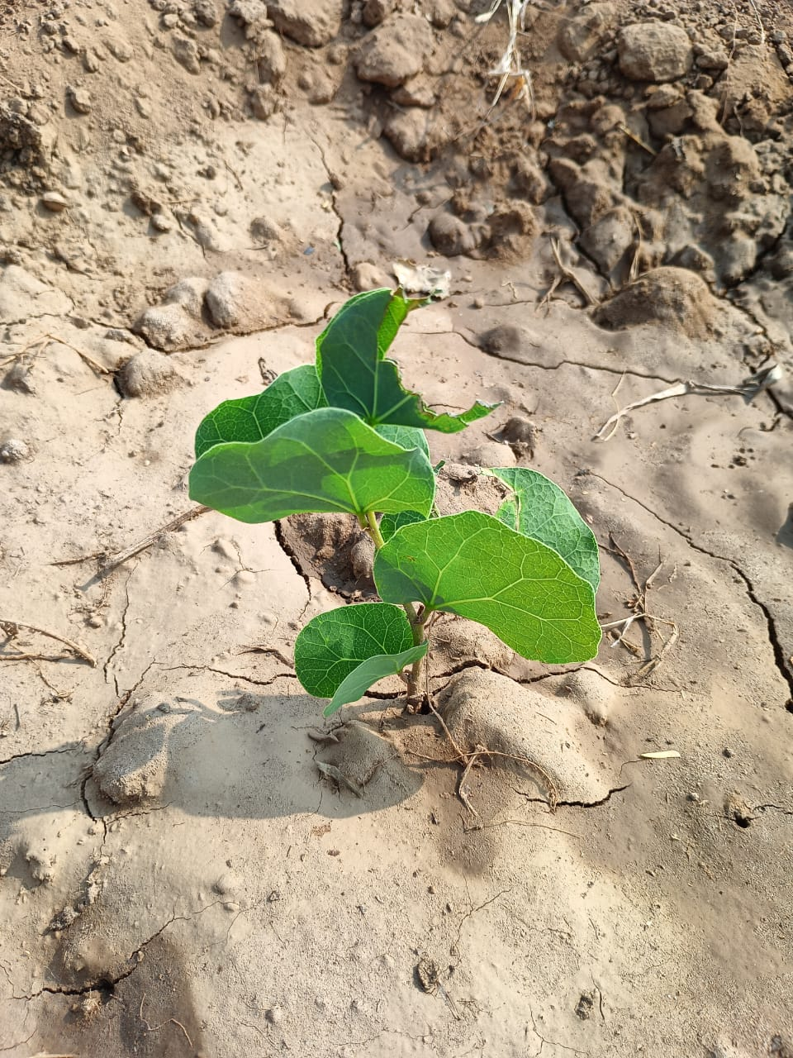

Slide 10
Future Work in Marama Bean
Study of the survival percentage of Maramabean
Multiplication of Maramabean after finding the suitable genotype
Training of Maramabean cultivation to the farmers
Publication and distribution of farmers friendly literature related maramabean

Slide 11
THANK YOU

